Slide 1


Introduction to Competitive Programming
Week 1: 4.26.20 - 5.2.20
Notes:
https://join.slack.com/t/introductiont-c5a2137/shared_invite/zt-djtdwpqu-S_tju9SZhk2IKhcYICitCQ

Slide 2
Hello!
I am Anish Mudide
Phillips Exeter ‘23
@amudide

Slide 3
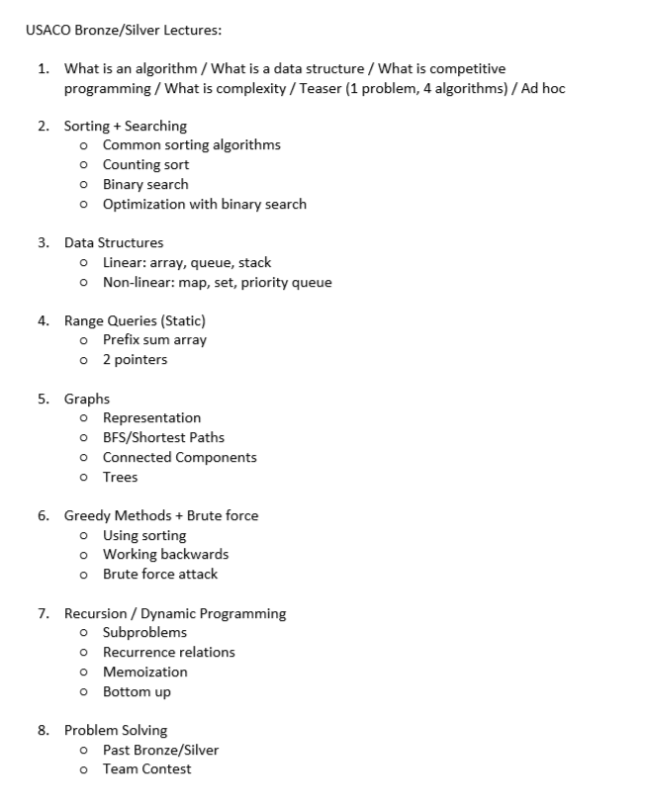




About this course*
Programming (Harnessing computer power)
Website Creation
Automation
Problem Solving / Algorithms
Notes:
Website: youtube.com
Automation: Facebook, whenever your friend posts something, like it
Problem Solving: Arguably the most valuable skill: it can be applied to so many areas and is what makes a company unique. Almost anyone can make a website, but people only know those who make the best sites. EXAMPLES: Google Maps: find the shortest route from point A to point B (Week 5). Students, tutors: each student has a rating for each tutor and each tutor rates each student; how do we pair them up -> stable matching. Self-driving cars: given a bunch of sensor data, how do we know when to accelerate, break etc.?
Questions asked on interviews for tech companies, and on prestigious programming contests. These are great for your resume, and best is USACO. By end, you’ll have all the skills you need to solve most Bronze questions and a really good foundation for Silver.

Slide 4
1.
Definitions

Slide 5
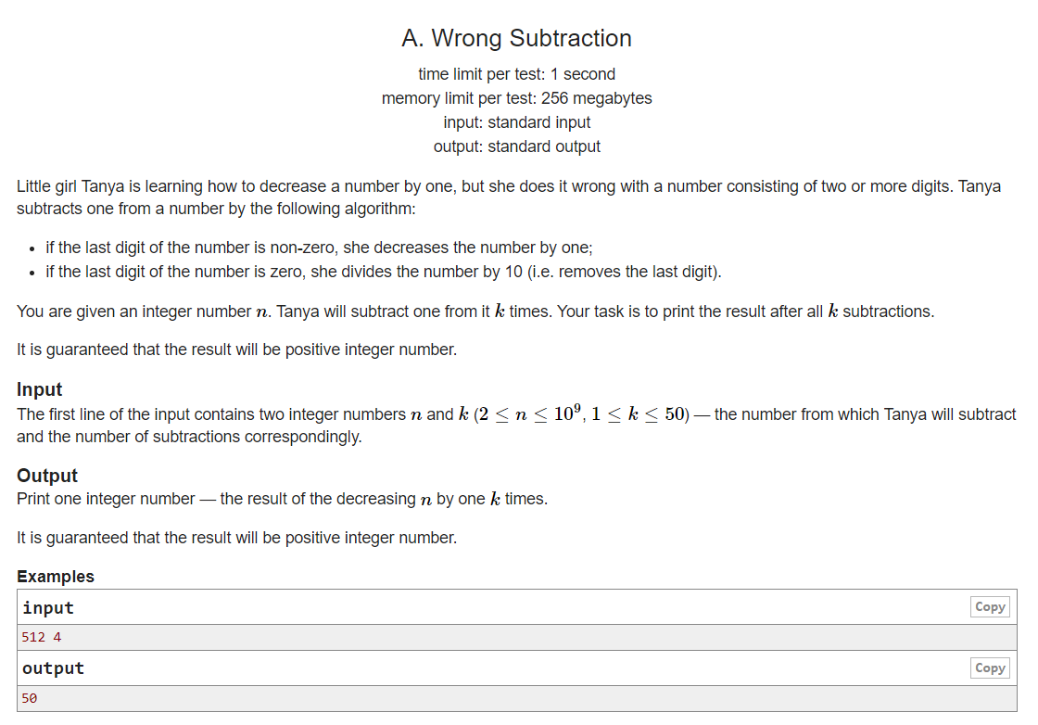
What is competitive programming?*
CodeForces 977/A
A mind sport held over the Internet
Structure
Host presents puzzles
Competitors write programs to solve them
Notes:
Connect to slide 3 -> problem solving. Present a fun scenario -> let’s read it. Simple, but later we will see examples where it’s more like Google Maps.
TALK ABOUT HOW PROGRAMMING WORKS. Box. input comes in, do logic, output.

Slide 6
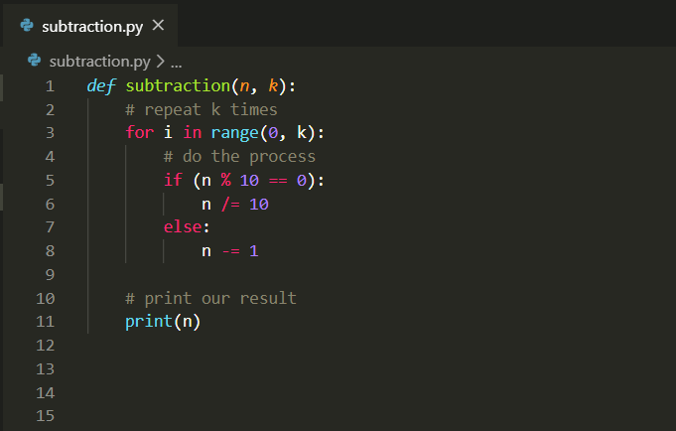


Pseudocode / Python
Competition Sites

Slide 7
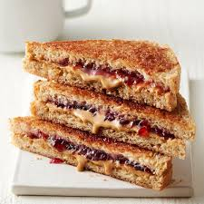
What are algorithms?
PB & J Sandwich
Problem Solving
Understand puzzle
Find the (best) algorithm
Write code to implement algorithm
“A finite sequence of well-defined, computer-implementable instructions, typically to solve a class of problems or to perform a computation.” - Wikipedia
Get a piece of bread.
Spread peanut butter on it.
Get another piece of bread.
Spread jelly on it.
Put the two pieces of bread together.
Eat it!

Slide 8
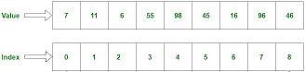
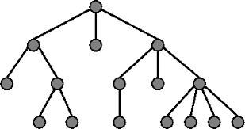
What is a data structure?*
Array
“A particular way of organizing data in a computer so that it can be used effectively.” - G4G.org
Operations
Access
Modify
Query
Tree
Notes:
Inputs can be more than just 2 numbers. What if we have 100 numbers?
Explain array: 3 operations

Slide 9
2.
Our First Challenge

Slide 10
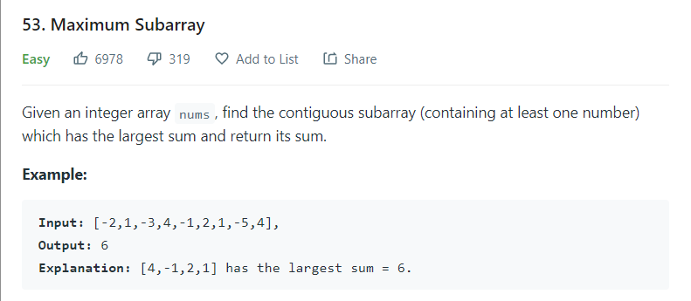
Problem Statement*

Slide 11
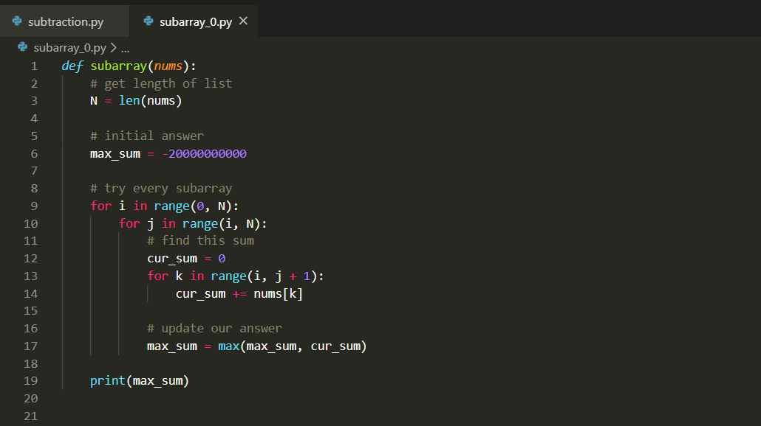
Slow Solution*
N = 100: 0.01 seconds
N = 1000: 8 seconds
N = 5000: Unreasonable

Slide 12
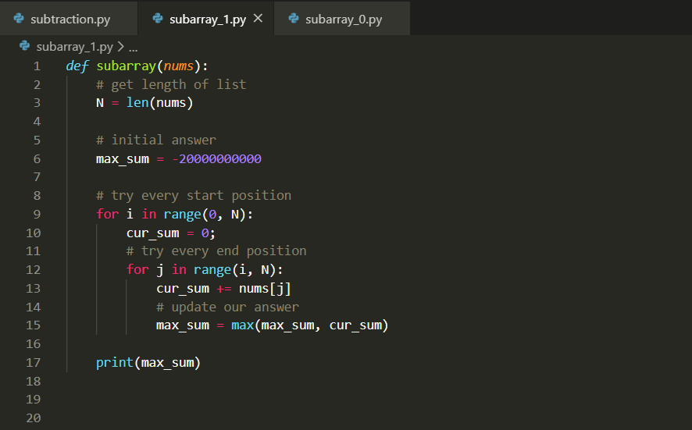
Fast(er) Solution*
N = 100: < 1 millisecond
N = 1000: 0.01 second
N = 10,000: 1 second
N = 50,000: 20 seconds

Slide 13
3.
Time Complexity

Slide 14
Introduction*
Describes the amount of time it takes to run an algorithm
A function of the input size
Approximation of the number of operations performed

Slide 15
Notation
Big O Notation
Suppose we have N numbers. Check how many are equal to 0
O(N)
Suppose we have N numbers. Find all possible sums of two numbers
O(N²)
Slow Solution
O(N³)
Fast(er) Solution
O(N²)

Slide 16
4.
Endnotes

Slide 17
Homework
Week 1: Ad-hoc
No knowledge of common algorithms required to solve
Highly encouraged
4 / week
Discussed on Slack
Leetcode

Slide 18
Set-up
Environments
VS Code / Atom / Sublime Text
Jupyter Notebook
Leetcode
https://leetcode.com/problems/maximum-subarray/

Slide 19
Thanks!
Any questions?
Contact:
amudide@gmail.com
Slack

